Slide 1

LARGE SCALE MATRIX COMPUTATION BY PARALLEL COMPUTING FINAL PROJECT
Advanced Computer Architecture CIS-600
Cleveland State University
Submitted to:Dr.Hongkai Yu
Submitted By: Pavuluru Anil

Slide 2
Objectives:
Computing Large Scale Matrix multiplication and addition using three Different Methods
Method-1SimpleMatrix
Method-2 Multi Multiply Matrix
Method-3 Custom Multiply Matrix
Executed each method for n values ranges from(2^4 to 2^20)
Tabulated and plotted the graph for the execution timing results obtained from each execution (2^4 to 2^14) for three different methods

Slide 3
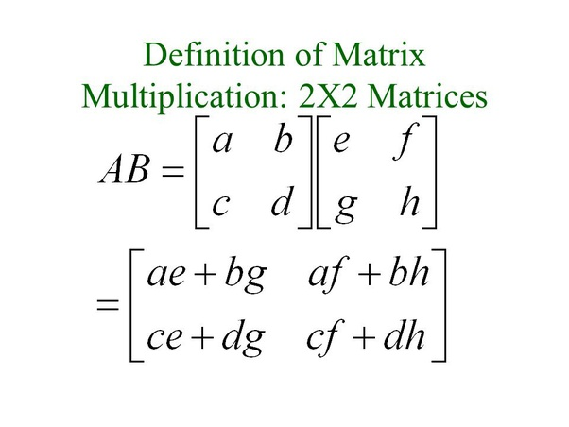
Matrix Multiplication
Number of columns of the 1st matrix must equal the number of rows of the 2nd matrix
And result will be the same number of rows as the 1st matrix and the same number of columns as the 2nd matrix
Multiply one matrix with another matrix we need “dot product” of rows and columns

Slide 4
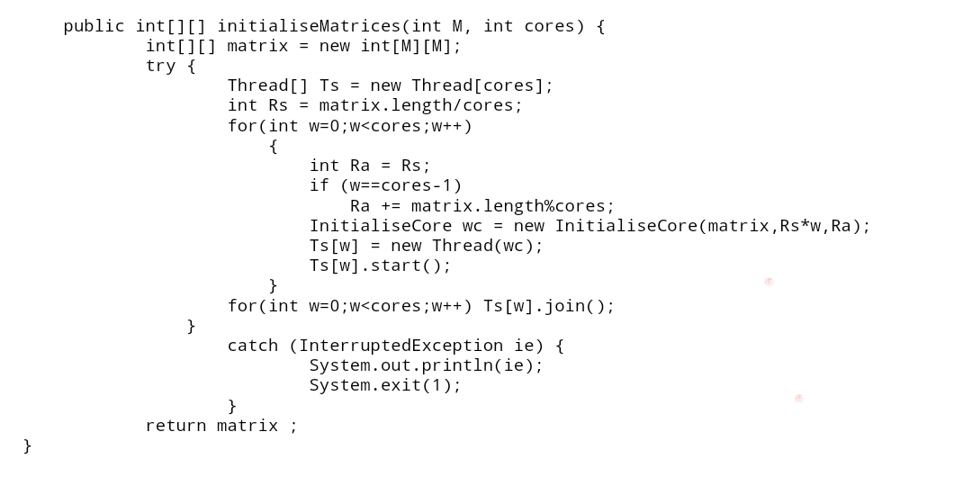
Initialization of Matrix
To use n*n to create 2n size of matrices with random numbers from -128 to128
Generate the matrix of order 2*n
Low=-128;high=128

Slide 5
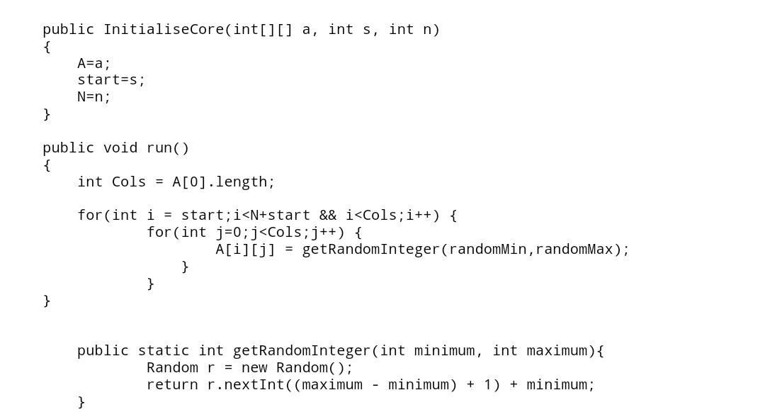
Assigning values in the 2-D Array for simple matrix
2-D Array object creating the Matrices
By using import java.util.Random function we assign random min and random max value.
For calculating time we use sw.start("Simple Matrix"); simpleMultiplyMatrices(X,Y); sw.stop();

Slide 6
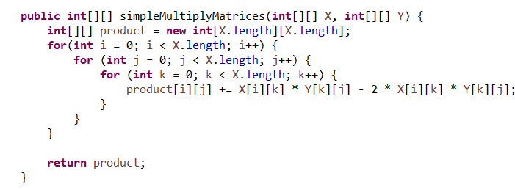
Logic
In this method we are going to compute the Large-Scale Matrix using Java
Concept behind the MATRIX Computation (X*Y-2*X+y)
First, Here in the project no worry because as clearly mention we taken “n” number of rows and columns for 1st and 2nd matrices
In a row-by-column matrix multiplication ,the entries in the ith-row of X are multiplied by the corresponding entries in the Jth column of Y and then adding the results until all the cells are calculated.
In row-by-column matrix addition we add all the corresponding cells and repeating this until all the cells are calculated.

Slide 7
Method-1Program Flow
Here we are going to demonstrate the program flow for computing Large Scale Matrix using Simple method in java
The following steps are performed for each value of n ranging (2^4 to 2^14)
Allocating memory for two matrices X and Y depending on the value Of n.
Initialize each value of X and Y matrices using random generator function between -128 to 128.
Calling the timer function and recording the start time.
Compute (X*Y)-2*X+Y.
Recalling the Stopwatch function and recording the end time of the execution.
Calculating the execution time from the start and end time and displaying it.
Exit from the program and freeing the memory space.

Slide 8
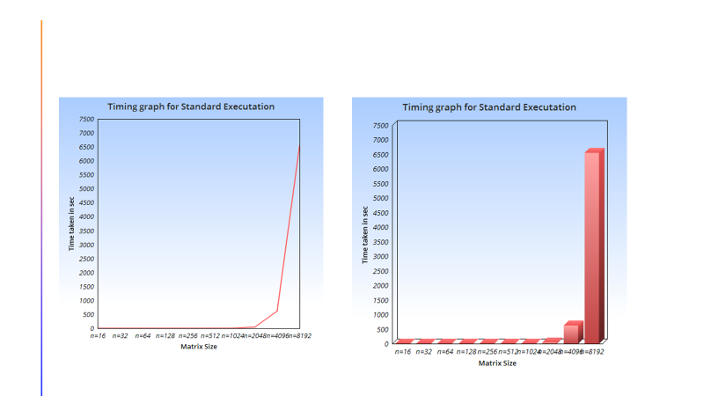
Graph of Simple Matrix
Simple Matrix | 0 | 1 | 4 | 10 | 31 | 263 | 3449 | 65254 | 83243 | 802606

Slide 9
Method-2 Multi Multiply Matrix Program flow
Here we are going to demonstrate the program flow for computing Large Scale Matrix using Multi Multiply Matrix in java
The following steps are performed for each value of n ranging (2^4 to 2^14)
Allocating memory for two matrices X and Y depending on the value Of n.
Initialize each value of X and Y matrices using random generator function between -128 to 128.
Calling the timer function and recording the start time.
Compute (X*Y)-2*X+Y. using row wise parallel calculation.
Recalling the Stopwatch function and recording the end time of the execution.
Calculating the execution time from the start and end time and displaying it.
Exit from the program and freeing the memory space.

Slide 10
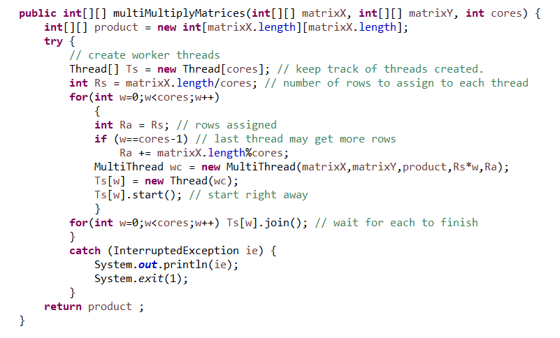
Logic

Slide 11
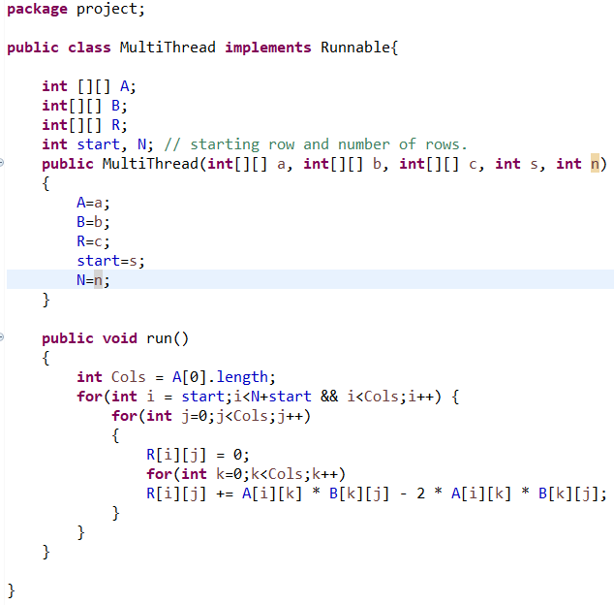
Assigning values
We creating sperate threads for finding of final products row wise parallelly.

Slide 12
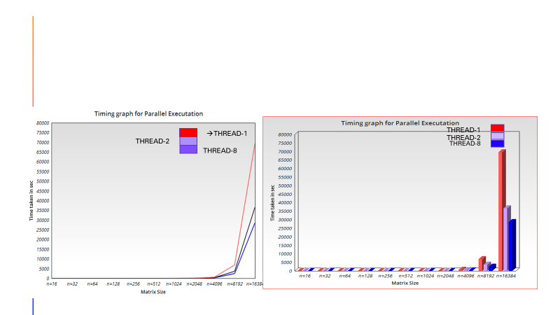
Graph
Multi Thread Matrix | 1 | 2 | 7 | 17 | 25 | 103 | 1141 | 25410 | 43790 | 414032

Slide 13
Method-3 Custom Multiply Matrix Program Flow
Here we are going to demonstrate the program flow for computing Large Scale Matrix using Multi Multiply Matrix in java
The following steps are performed for each value of n ranging (2^4 to 2^14)
Allocating memory for two matrices X and Y depending on the value Of n.
Initialize each value of X and Y matrices using random generator function between -128 to 128.
Calling the timer function and recording the start time.
Compute (X*Y)-2*X+Y. using inner class approach along with math.min function.
Recalling the Stopwatch function and recording the end time of the execution.
Calculating the execution time from the start and end time and displaying it.
Exit from the program and freeing the memory space.

Slide 14
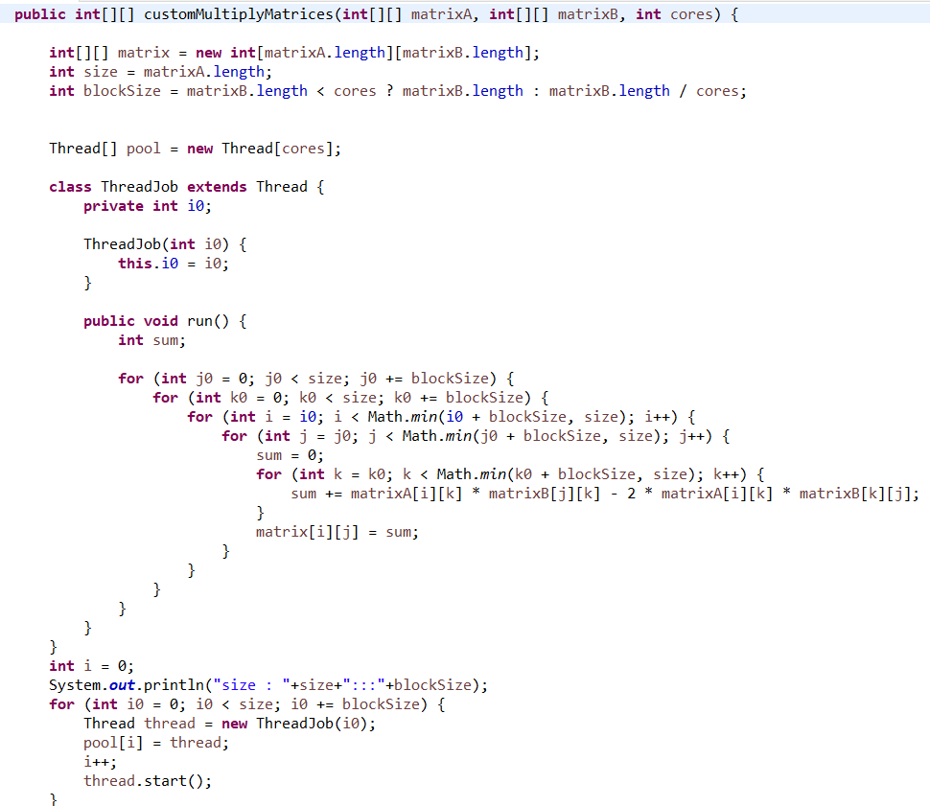
Logic

Slide 15
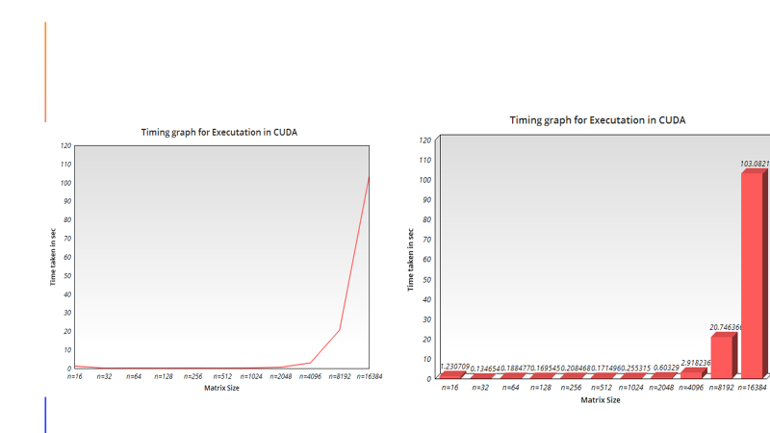
Graph
CustomParallel ThreadMatrix | 1 | 1 | 13 | 37 | 73 | 128 | 769 | 11941 | 16129 | 303127

Slide 16
Tabulated results
Matrix size | 2⁴ | 2⁵ | 2⁶ | 2⁷ | 2⁸ | 2⁹ | 2¹⁰ | 2¹¹ | 2¹² | 2¹³
Simple Matrix | 0 | 1 | 4 | 10 | 31 | 263 | 3449 | 65254 | 83243 | 802606
Multi Thread Matrix | 1 | 2 | 7 | 17 | 25 | 103 | 1141 | 25410 | 43790 | 414032
CustomParallel ThreadMatrix | 1 | 1 | 13 | 37 | 73 | 128 | 769 | 11941 | 16129 | 303127
Total time in milliseconds for all tasks | 2 | 5 | 26 | 64 | 130 | 495 | 5360 | 102607 | 143163 | 1519765

Slide 17
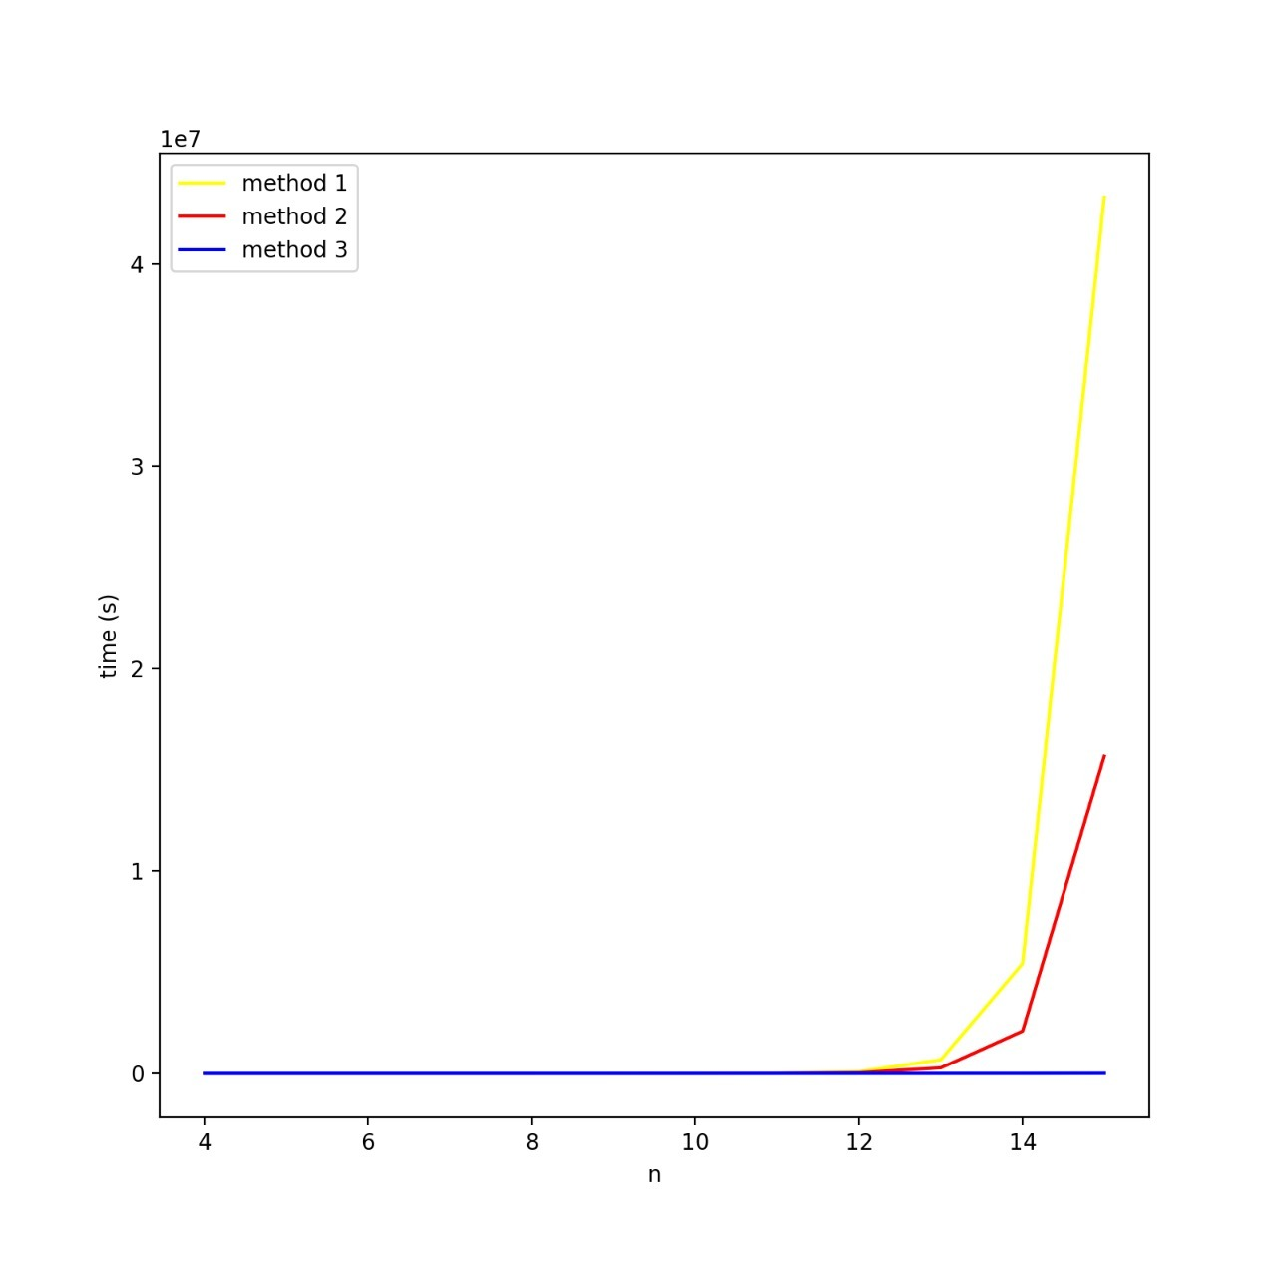
Three Method Graph Comparison

Slide 18
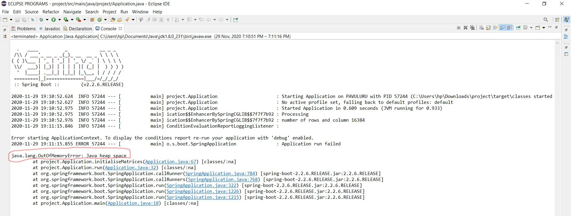
Limitations:
We came to know that all our three methods are not executing after n=2^14
This happens due to our program is running out of memory while initializing the matrix of size n=2^14
During initialization heap memory allocated for the particular process in the program by the memory manager is going out of bound and execution get stopped

Slide 19
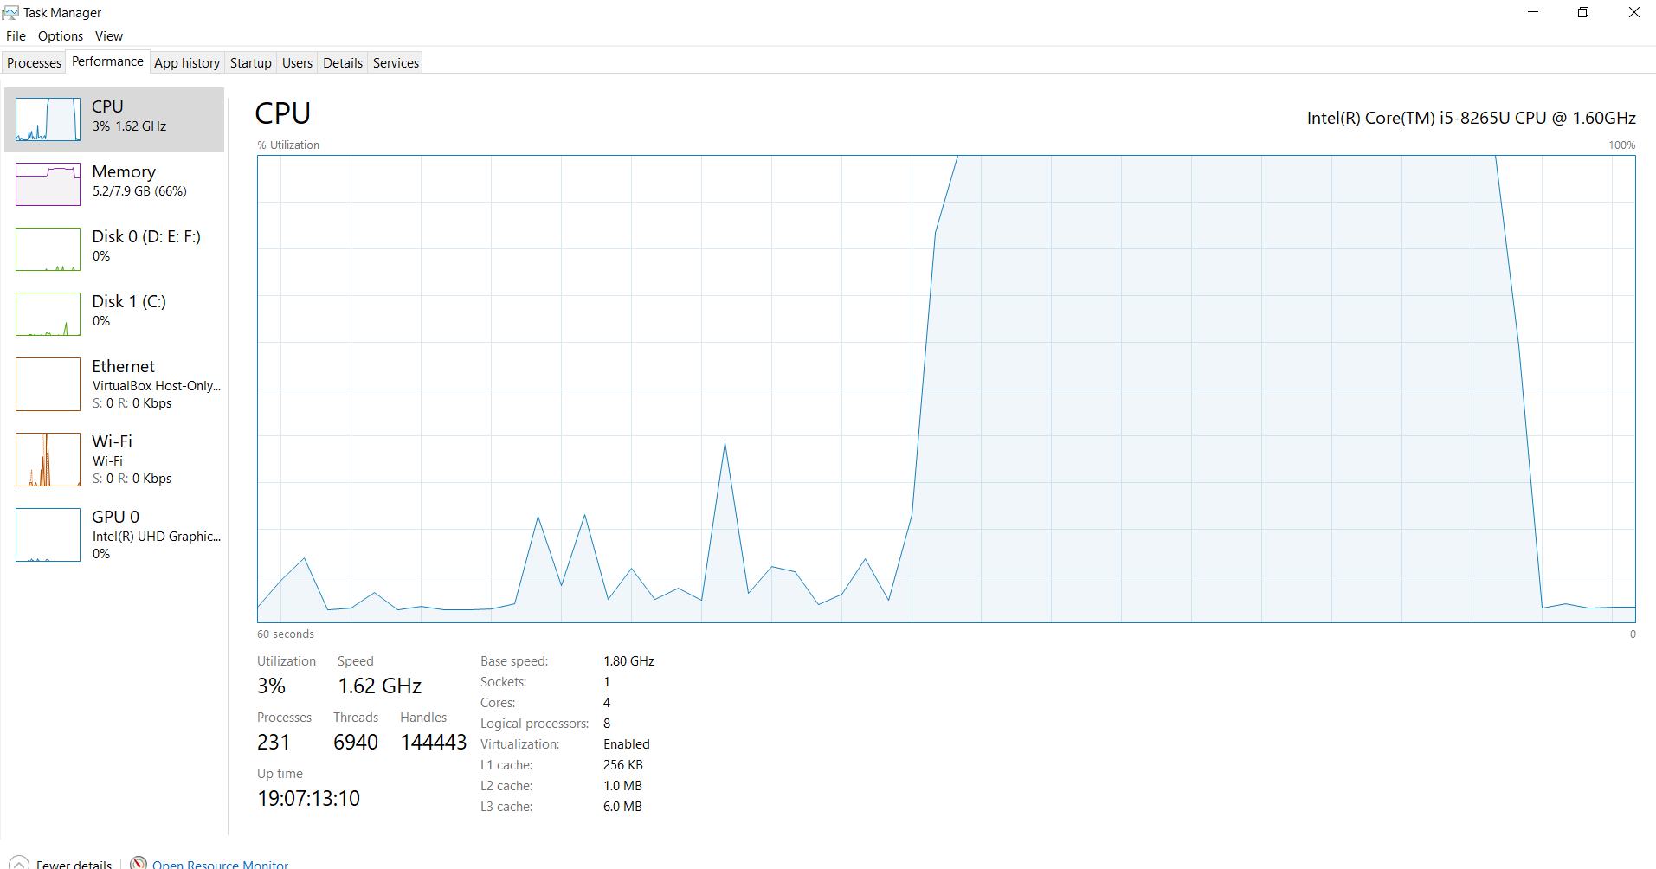
Performance:

Slide 20
THANK YOU
FOR YOUR ATTENTION

